Slide 1
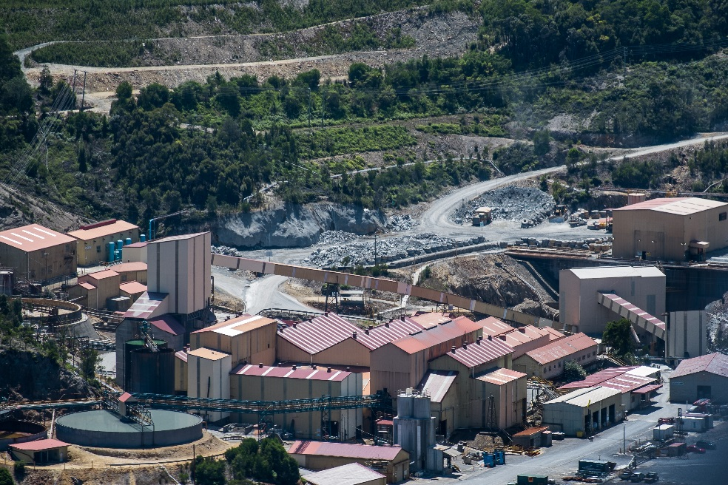
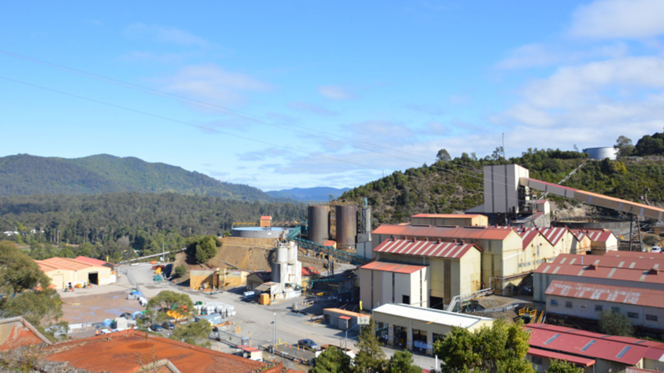
Groundwater & Surface Water Data Management
MMG Rosebery Mine, Tasmania
Tom Wilson (EScIS) & Joe Kwan (MMG)

Slide 2
Presentation Overview
Mine Operations
Site hydrology & hydrogeology
Why monitor?
Monitoring program
Monitoring event plan → field data capture → review
Lab data receipt, validation & data analysis
Data outputs/reporting & sharing of data
Benefits of the EScIS system at MMG

Slide 3
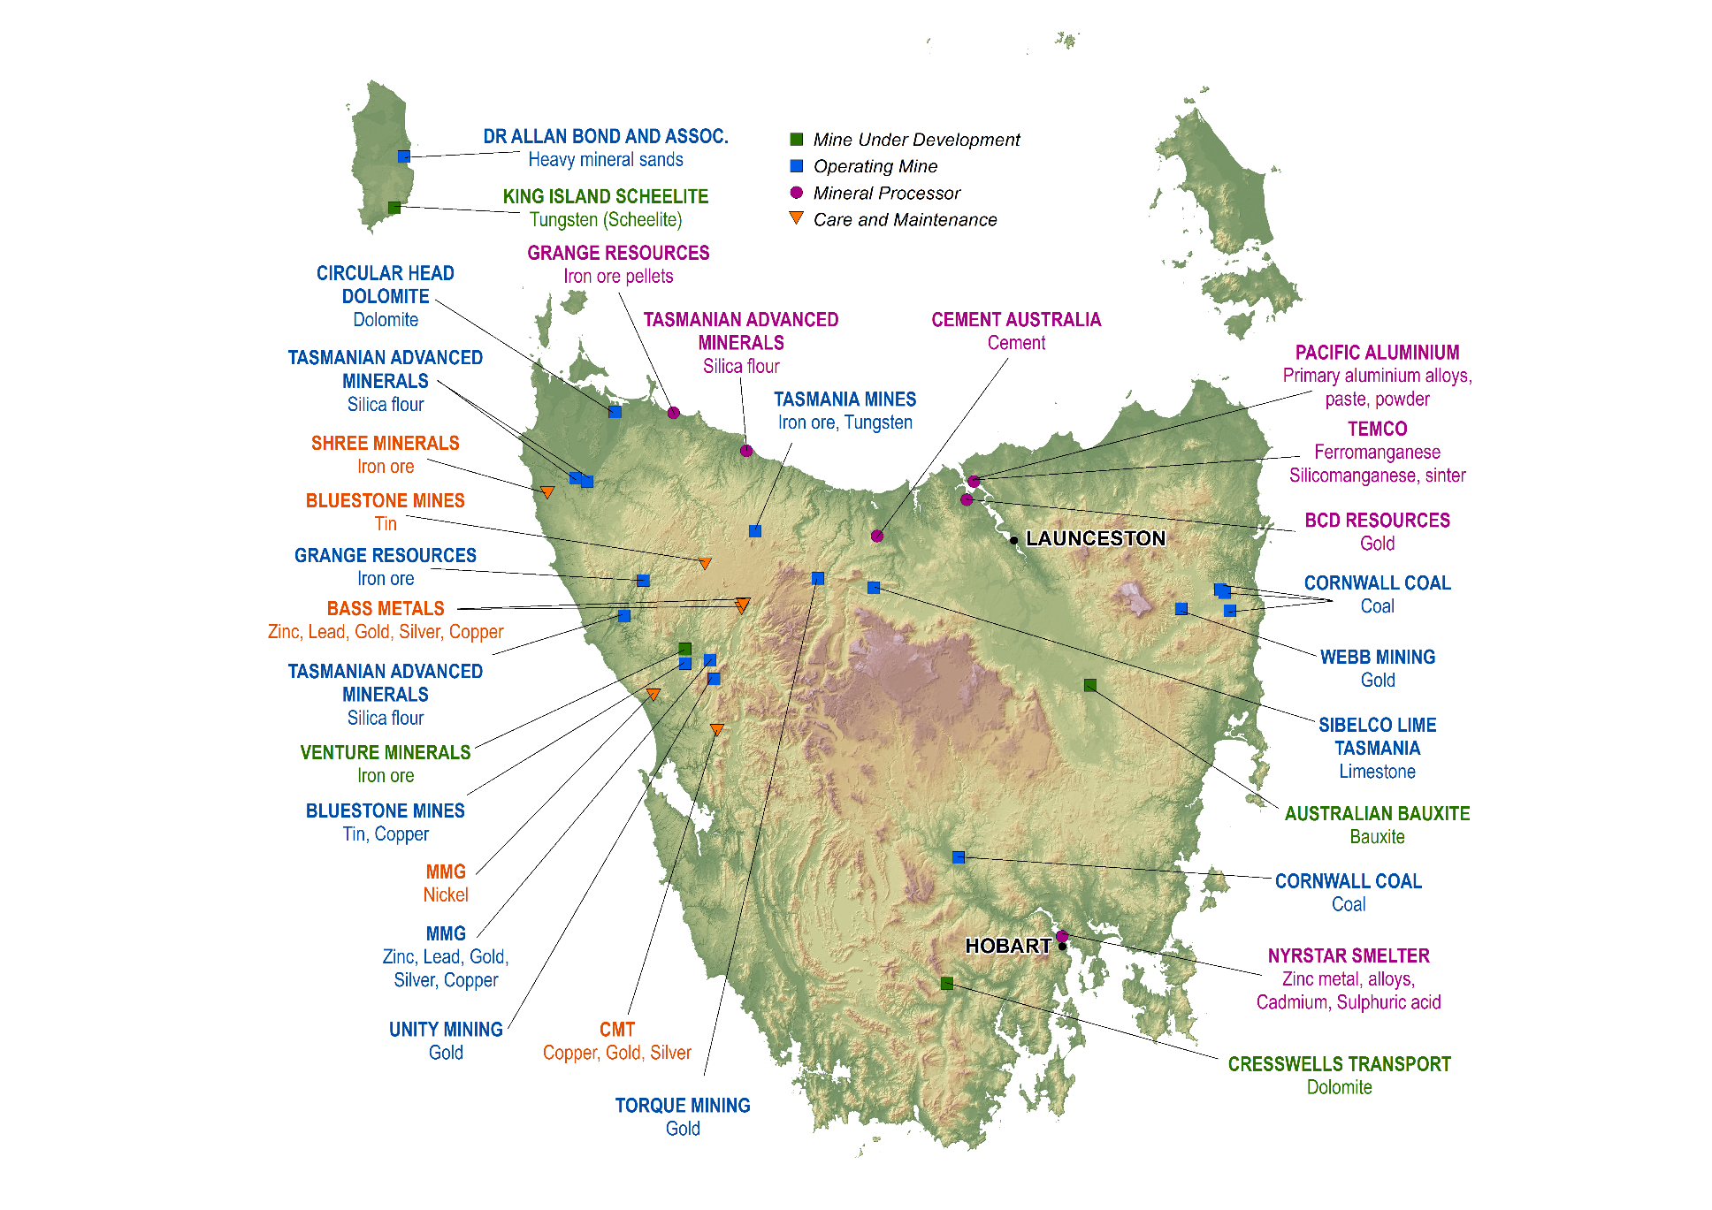
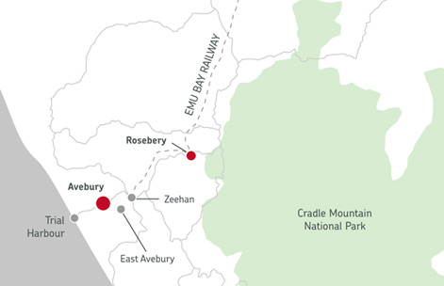
Rosebery Location

Slide 4
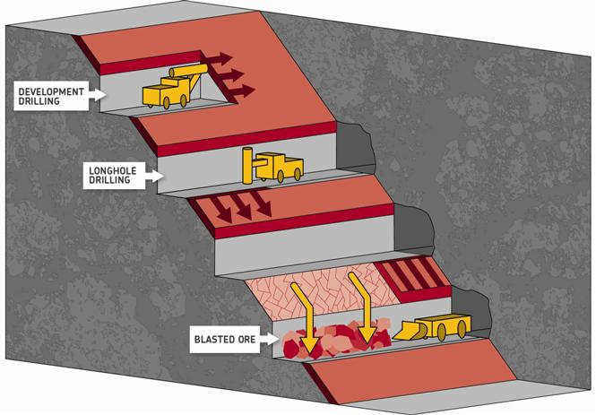
Rosebery Operations
Underground poly-metallic base metal mine
Commenced 1936, mine life to 2024
Open stopes extract ore from up to 1500m depth
Ore trucked to surface for crushing & processing

Slide 5
Rosebery Operations
Produces zinc, lead, copper concentrates & gold doré
Gold recovered by gravity, remainder by froth floatation
Concentrates shipped to Nyrstar (Hobart & Port Pirie)
Gold shipped to Perth

Slide 6
Hydrology & Hydrogeology*
Sulphide deposit within Cambrian Mount Read Volcanics
Mine data indicates:
top 100m = increased permeability (weathering);
shear zones and faults = increased permeability;
below 100m, uniform permeability decrease with depth
Groundwater flow system typified by a deep fractured aquifer (containing the mine voids), overlain by surficial glacial deposits & weathered material
*LR Evans 2009

Slide 7
Hydrology & Hydrogeology
Significant SW/GW interaction throughout catchment
Regional rainfall >> evapotranspiration (dense vegetation)
Catchment water budget:
42% (of precipitation) runs off as surface water flow
24% lost to evapotranspiration
17% becomes groundwater, discharged as baseflow into creeks & rivers within the catchment
18% remains as groundwater discharge beyond the catchment
Mined materials are potential sources of Acid Mine Drainage:
tailings dams waste rock mine workings

Slide 8
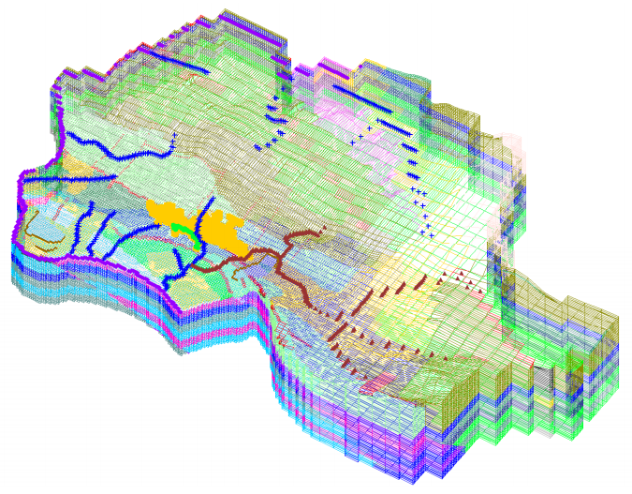
Hydrology & Hydrogeology
3D model suggests the potential area for mine contaminated groundwater discharge is far more limited than was previously believed by mine operators

Slide 9
Hydrology & Hydrogeology
Understanding the areas of potential impact:
focusses monitoring point distribution
focusses future modelling efforts
Background monitoring used to test the model & provide data for future model calibration/validation
Thus the quality and validity of monitoring is critical to ongoing operations and mine closure plan
i.e. garbage in = garbage out

Slide 10
Environmental Protection Notice
EPN specifies sample locations, frequency & analysis (informed by model)
Primarily to monitor potential AMD impacts
Broad range of WQ parameters & analytes
pH, EC, TDS
Fe, Mn, Zn, Ni, Cu, Pb, Cd, As, Hg, Al
Nitrate, TN, TP, SO4, Ca, Mg
Acidity & alkalinity
TPH, BTEX

Slide 11
Water Monitoring Program
10 SW sites → weekly
20 SW sites → monthly
40 SW sites → quarterly
50 GW bores monitored bi-annually (wet & dry seasons)
Field parameters + laboratory analysis
(also 13 dust gauges, 8 Hi-Vol air samplers, plus continuous noise, vibration & meteorological loggers)
Result → Large volumes of field, lab (& logger) data

Slide 12
EDMS
MMG have the EScIS Environmental Data Management System
Operates from a central SQL server database (DB)
DB hosted on-site server
Three integrated ‘off-the-shelf’ applications:
LSPECS Field event planning, PM & validation
pLog Field data capture
ESdat Analysis, interpretation, outputs
All applications talk to the one SQL DB

Slide 13
LSPECS
Key functions:
Field program design/planning & delegation
Field program tracking (all projects, auto-create repeat events)
Review/validation of field & lab results
Web browser interface – intuitive design
Import all laboratory details (quotes, sample bottles etc.)
Design a complete SAQP (QA samples, field readings, docs etc.)
Assign trigger criteria (published or derived)

Slide 14
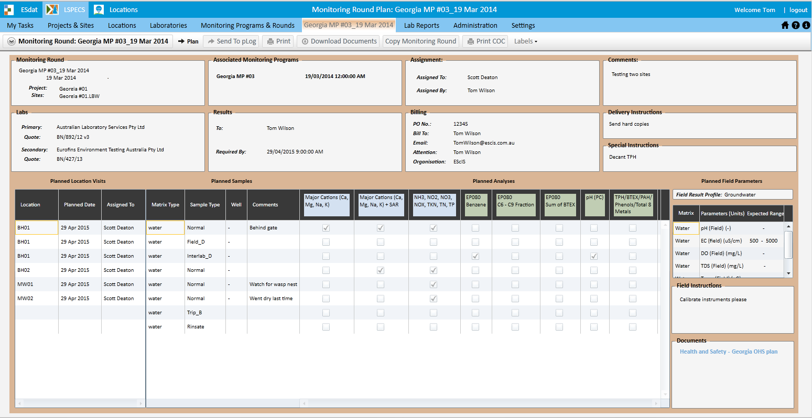
Monitoring Round - Plan

Slide 15
pLog
Android or windows tablet software
LSPECS sample plan ‘synced’ to pLog tablet over cloud (3-4G/wifi)
Full electronic data capture on one device:
Field parameters & sample information
Geological bore logs
Photos (geotagged)
GPS locations (new sample points, find existing)
pLog will operate online or offline – works remotely
Captures planned or ad-hoc data

Slide 16
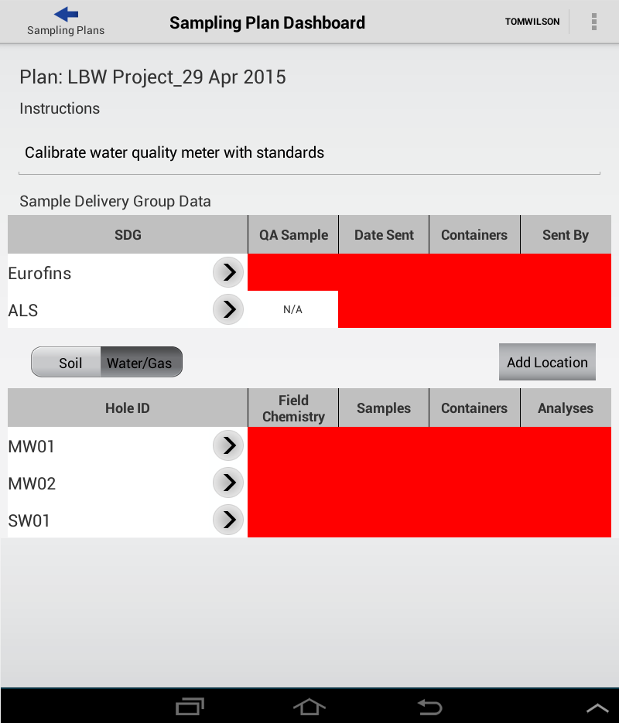

Slide 17
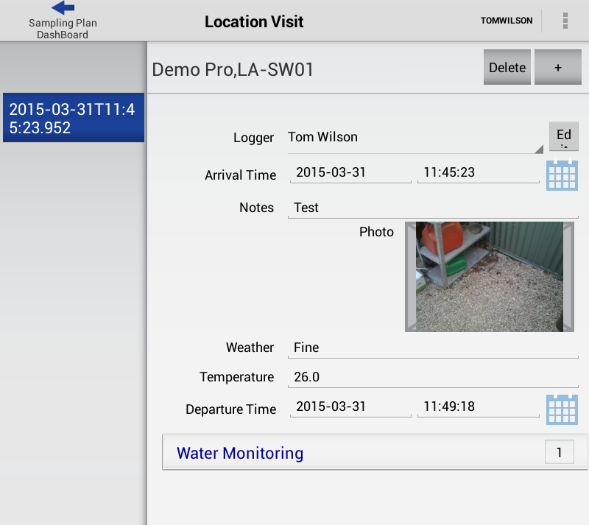
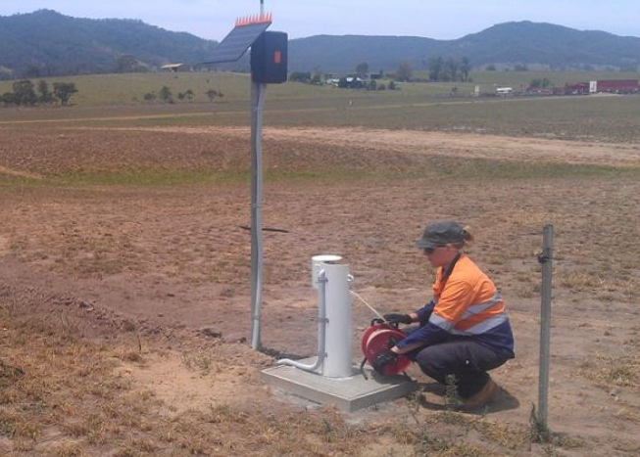

Slide 18
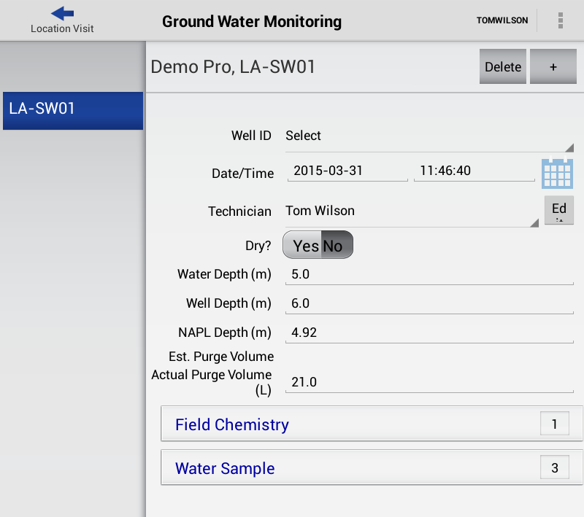

Slide 19
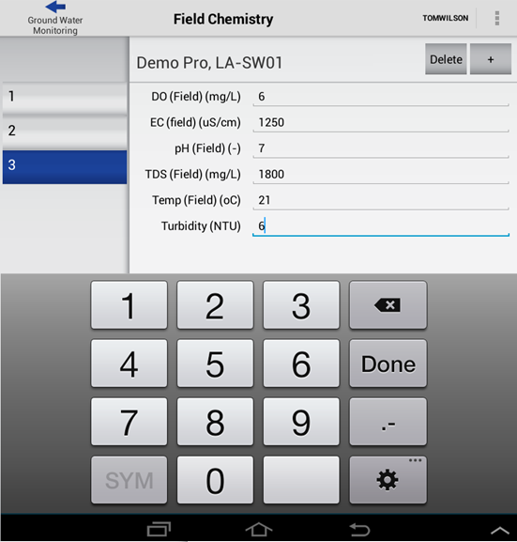

Slide 20
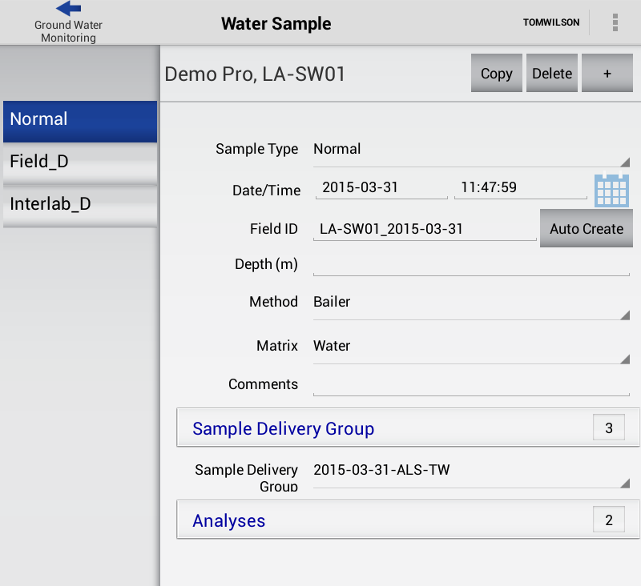

Slide 21
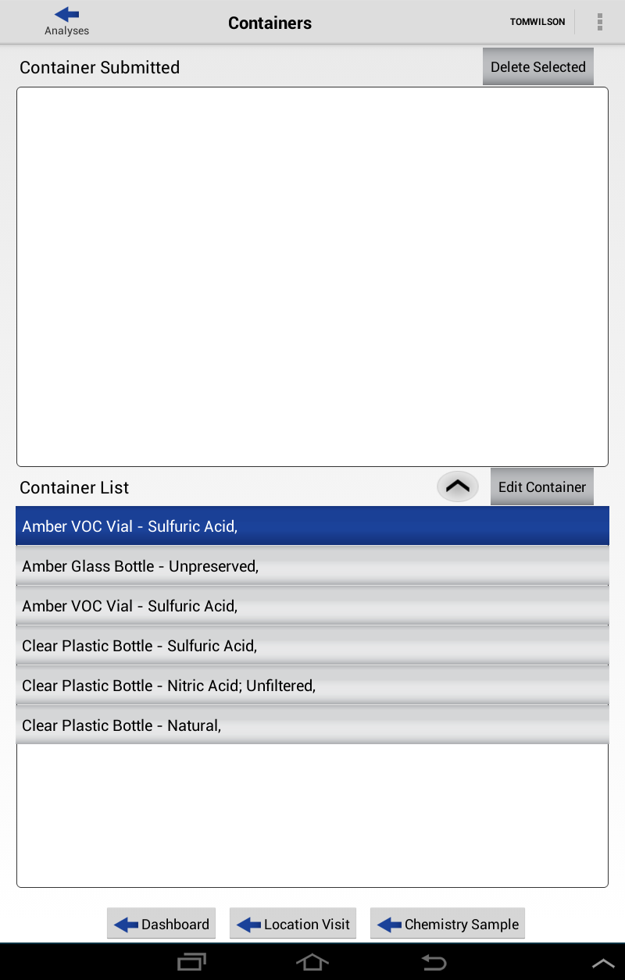

Slide 22
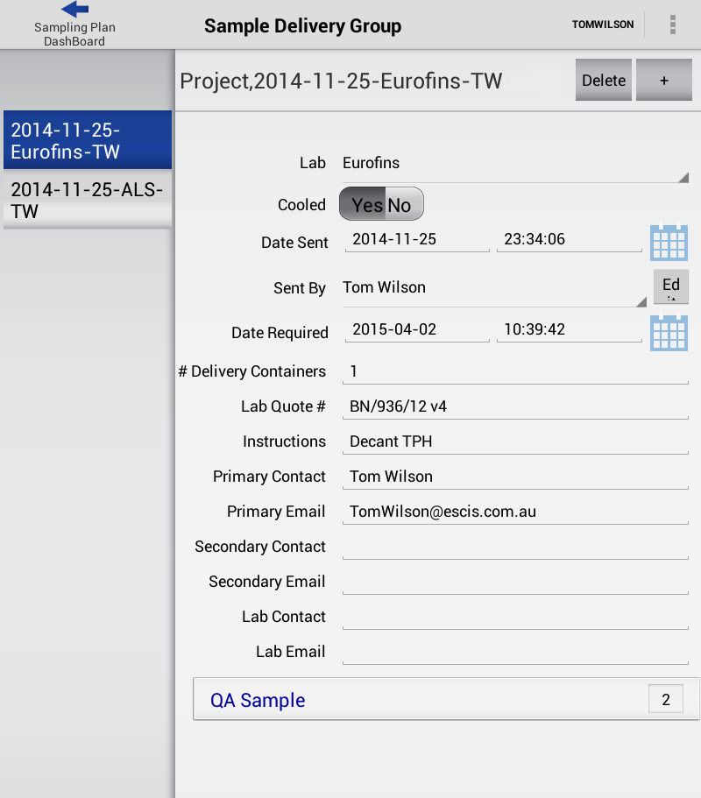

Slide 23
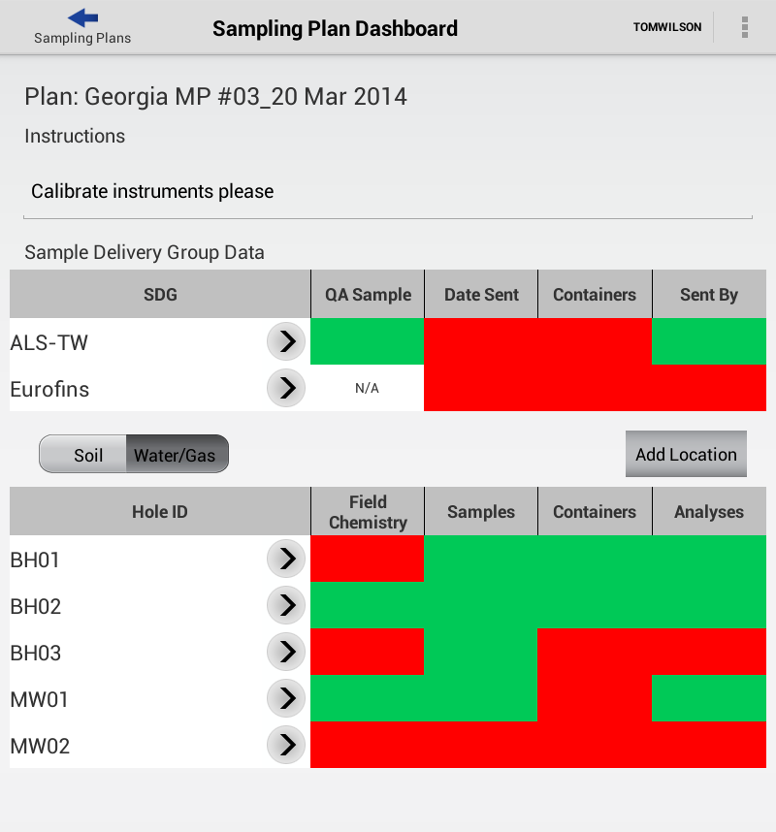

Slide 24
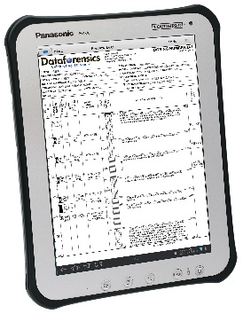
LSPECS/pLog Workflow
Create sampling plan
from LSPECS in office
Conduct sampling & collect field/sample data
Sync via cloud to pLog
installed on tablet
Data synced back to LSPECS
From LSPECS review field data Submit lab analysis
SRN
Review & approve lab analysis
Detailed analysis in ESdat

Slide 25
LSPECS
Sync completed round from pLog back to LSPECS (via cloud)
In LSPECS:
Review field data
Review lab analysis request (new/missing samples?)
Submit analysis request electronically to lab (into LIMS)
Receive electronic SRN (auto check TAT)

Slide 26
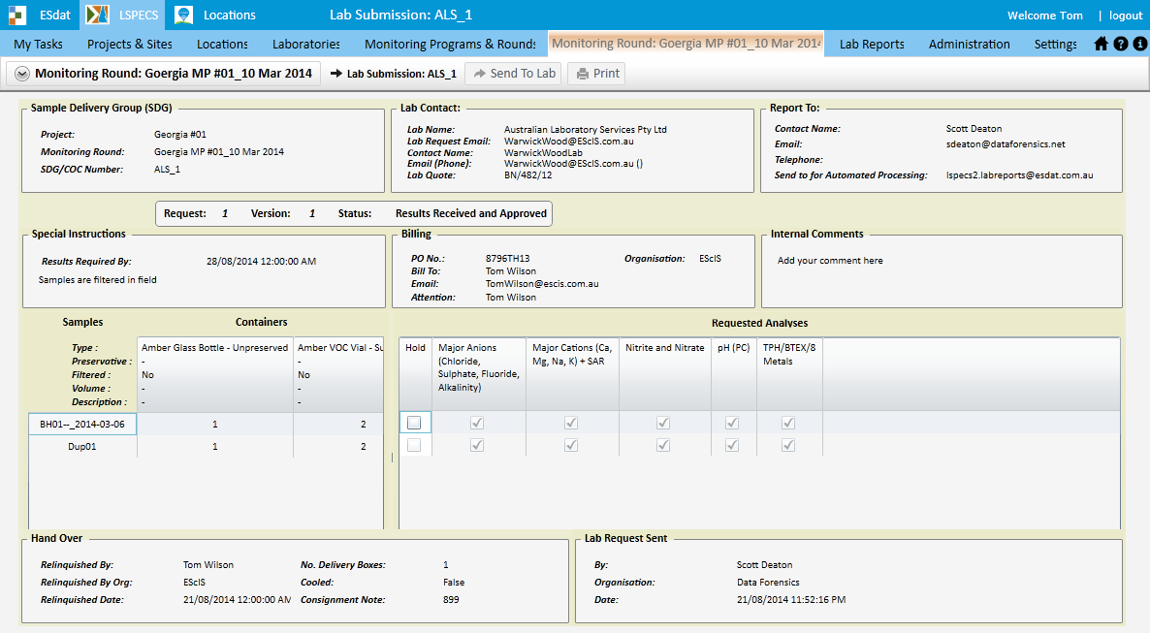
Lab Submissions

Slide 27
LSPECS – lab analysis data review
Receive lab results in ESdat format – auto upload
Auto comparison with trigger criteria
Immediate (email) notification (customisable)
Review data quality
Attach QA commentary to analysis (shared amongst team)
Run full field & lab QA (RPDs, TBs, LCS, MB etc)
If acceptable, approve event & data for ESdat analysis

Slide 28
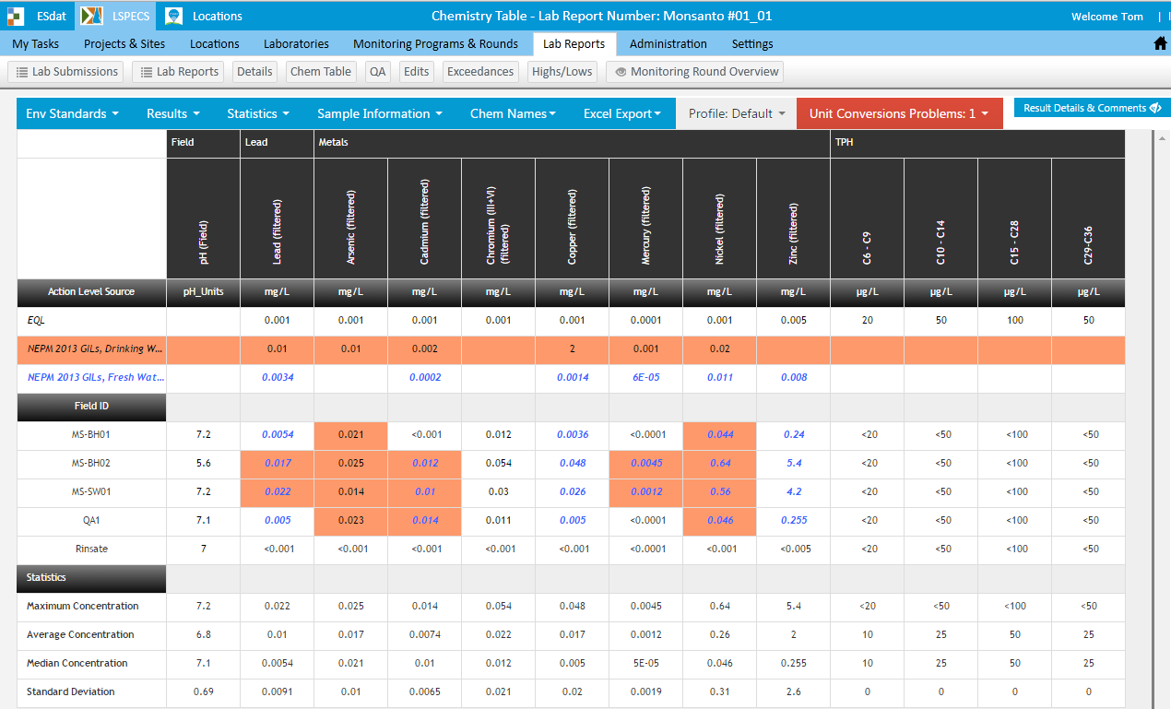
Tabulated Lab Results

Slide 29
Benefits of LSPECS/pLog at MMG
Centralised data storage & project management
Easy creation of field events & resource management
Auto-scheduling of events = no missed rounds or scope errors
No field data sheets = no manual transcription saves time & reduces errors
Validation processes = confidence in achieving DQOs
Auto notification of issues (e.g. exceedence, QA) = rapid response

Slide 30
ESdat
LSPECS approved data becomes available for analysis in ESdat
ESdat desktop software – specifically designed interface
Manages many data types in one SQL dbase, including:
Coordinates (for mapping) Chemistry (any matrix)
SW Flow data Water levels
Well construction Geology
Env. standards/criteria Emissions (dust, noise)

Slide 31
Powerful ESdat Features
Easily combine data types via queries:
e.g. Coordinates + Chemistry → interrogate via internal GIS
Create, save and re-use complex data filters
Quickly isolate data subset of interest
Stop using Excel!
Export directly to third party software from one DB
Formatted tables & graphs, ProUCL, Piper/Schoeller diags
gINT/Winlog ArcGIS/Mapinfo/Google Earth/Surfer/CAD
e.g. Coordinates + Water levels → Surfer for contours

Slide 32
Benefits of ESdat at MMG
Seamless integration of new data with historical data
Monitor long term trends (auto update existing graphs)
Easily create scheduled/ad-hoc outputs for EPA in required format
Incident response – data is readily available
Quickly generate outputs to suit external consultants
Reporting (share data in ESdat format or Excel tables)
Modelling (Excel & pivot tables)
Easy transition as staff come & go (no unsupported customisations)

Slide 33
Future MMG EDMS expansion
Implementation of the EDMS = step change in operations
This change needs to be managed with a long term view
Application of suitable EDMS features = real productivity increase
Less time managing data = more interpretation time
= better science (& less risk)
MMG looking to expand use of EDMS to other data types:
Terrestrial (biological) monitoring
Aquatic monitoring

Slide 34
Acknowledgements
Groundwaters in wet, temperate, mountainous, sulphide-mining districts: delineation of modern fluid flow and predictive modelling for mine closure (Rosebery, Tasmania)
Lee R. Evans, PhD thesis, UTas, 2009

Slide 35
Thank you
www.esdat.com.au

